Slide 1
EPAM JavaLab
Exceptions
© 2015. EPAM Systems. All Rights Reserved.
Notes:
add constructors

Slide 2
Exceptions
Was executed without exceptions?
public void attackArmy(Army army)
1 – good
0 – bad (no droids in army)
-1 – crap!
public int attackArmy(Army army)
public Droid getRandomDroid(Army army)
© 2015. EPAM Systems. All Rights Reserved.

Slide 3
Exceptions - concept
public Droid getRandomDroid(Army army) throws EmptyArmyException
try{
}
Droid droid = getRandomDroid(army);
catch(EmptyArmyException e){
finishBattle();
}
public Droid getRandomDroid(Army army) throws EmptyArmyException{
if(army.isEmpty()){
throw new EmptyArmyException();
}
...
}
© 2015. EPAM Systems. All Rights Reserved.

Slide 4
Exceptions - call stack
public void startArmiesFight()
public void attackArmyByDroid(Droid droid,Army army) throws EmptyArmyException
public Droid getRandomDroid(Army army) throws EmptyArmyException
© 2015. EPAM Systems. All Rights Reserved.

Slide 5
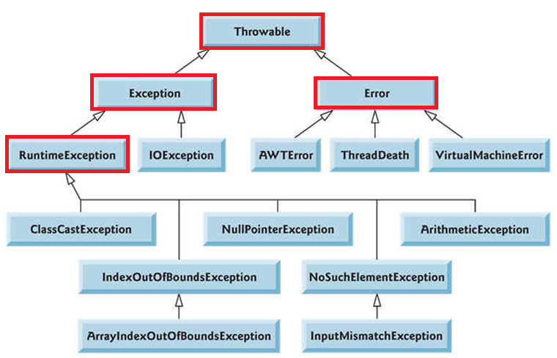
Exceptions
are java objects
© 2015. EPAM Systems. All Rights Reserved.

Slide 6
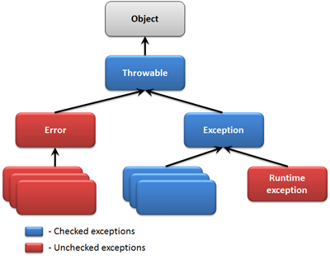
Exceptions – checked vs. unchecked
© 2015. EPAM Systems. All Rights Reserved.
Notes:
Checked exceptions in Java extend the java.lang.Exception class. Unchecked exceptions extend the java.lang.RuntimeException.

Slide 7
Exceptions - errors
VirtualMachineError
StackOverflowError
InternalError
OutOfMemoryError
© 2015. EPAM Systems. All Rights Reserved.

Slide 8
Exceptions - handling
try
try{
Droid droid = new Droid(12,23,45)
army.addDroid(droid);
}
catch(ArmyTooPowerfullException e){
System.out.println(“sorry” +
+ ” – army is too powerfull”);
}catch(AmryToLargeException e){
System.out.println(“sorry” +
+ ” – army is too large”);
}
catch
finally
finally{
server.sendHideousData(“user trying” +
+ “to add a droid”);
}
always !!!
© 2015. EPAM Systems. All Rights Reserved.
Notes:
Imagine that an exception is thrown from inside the try block. Then the finally block is executed. Imagine then, that an exception is also thrown from the finally block. Which exception do you think is propagated up the call stack?
The exception thrown from the finally block would be propagated up the call stack, even if the exception thrown from the try block would probably be more relevant to propagate.

Slide 9
Exceptions - handling
try
try{
Droid droid = new Droid(12,23,45)
army.addDroid(droid);
}
catch(ArmyTooPowerfullException |
AmryToLargeException e){
System.out.println(“sorry” +
+ ” – there where exception”);
}
multi-catch
finally
finally{
server.sendHideousData(“user trying” +
+ “to add a droid”);
}
always !!!
© 2015. EPAM Systems. All Rights Reserved.

Slide 10
Exceptions – try with resources
try
(BufferedWriter writer = Files.newBufferedWriter(file, charset))
{
writer.write(s, 0, s.length());
} catch (IOException x) {
System.err.format("IOException: %s%n", x);
}
© 2015. EPAM Systems. All Rights Reserved.
Notes:
AutoClosable

Slide 11
Exceptions - little more
throw new ArmyTooPowerfullException(“droids have too many guns”);
Exception
message
parent exception
throw new ArmyTooPowerfullException(armyTooBigException);
© 2015. EPAM Systems. All Rights Reserved.

Slide 12
Exceptions - tricks
class AmryToLargeException extends Exception{}
try{
throw new AmryToLargeException();
}catch(Exception e){
System.out.println(“sorry – strange error” +
+ e.getMessage());
}catch(AmryToLargeException e){
System.out.println(“sorry” +
+ ” – army is too large”);
}
© 2015. EPAM Systems. All Rights Reserved.
Notes:
It is a good idea to create a base exception for your API or application, and have all other exceptions subclass this base exception. Individual subclasses makes it possible (but not obligatory) to catch and handle these individual exceptions differently. You should create individual exceptions only for errors that can actually be handled differently.

Slide 13
Exceptions – Fail Safe
Exception Handling
InputStream input = null;
try{
input = new FileInputStream("myFile.txt");
//do something with the stream
} catch (IOException e){
throw new WrapperException(e);
} finally {
try{
input.close();
} catch (IOException e){
throw new WrapperException(e);
}
}
© 2015. EPAM Systems. All Rights Reserved.

Slide 14

Exceptions - handling
try{
Droid droid = new Droid(12,23,45)
army.addDroid(droid);
}catch(ArmyTooPowerfullException e){
}catch(AmryToLargeException e){
}finally{
}
© 2015. EPAM Systems. All Rights Reserved.

Slide 15
Q&A
© 2015. EPAM Systems. All Rights Reserved.

Slide 16
Task
Add custom exceptions to projects "Fibonacci numbers" and "Battle of droids".
Create your own AutoCloseable class, and try how it works in try-with-resources.
Throw some exception in close() method of your AutoClosable class and watch what will happen.
© 2015. EPAM Systems. All Rights Reserved.

